Slide 1
Project : Predictors of mental health illness
University of
Technology and Education
Machine Learning
Instructor: Trần Nhật Quang
Team: 7
Team members:
Lâm Hoàng An _18110073
Lê Công Nghĩa _16110165

Slide 2
Table of content
UML game Chess
Player vs Player
Player vs Com
Heuristic & Minmax
4. Some features
5. References

Slide 3
Giới thiệu project
1

Slide 4
Data
2

Slide 5

Lấy dữ liệu ở đâu ?

Slide 6
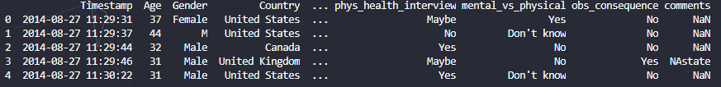
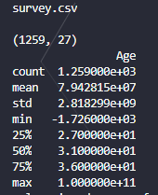
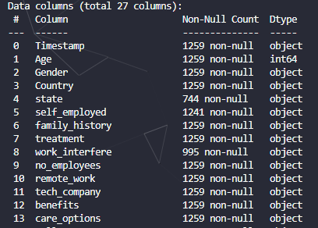
Load data

Slide 7
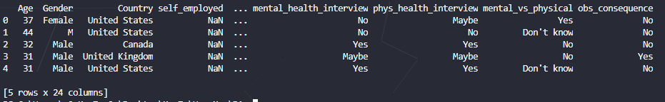
Drop feature
1. Data chưa Drop feature
2. Drop feature

Slide 8
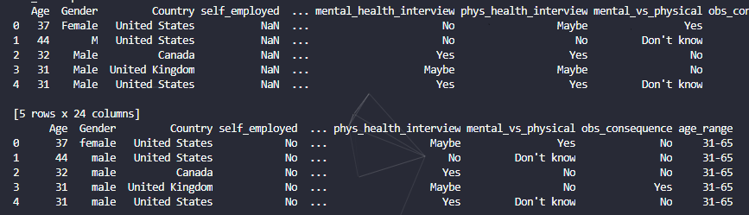
Cleaning data

Slide 9
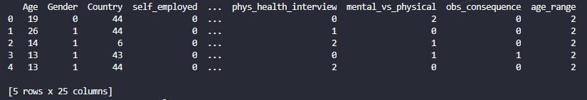
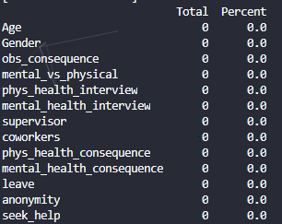
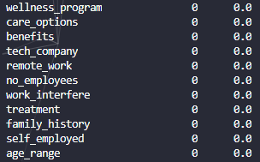
Encoding data
Kiểm tra
missing Data

Slide 10
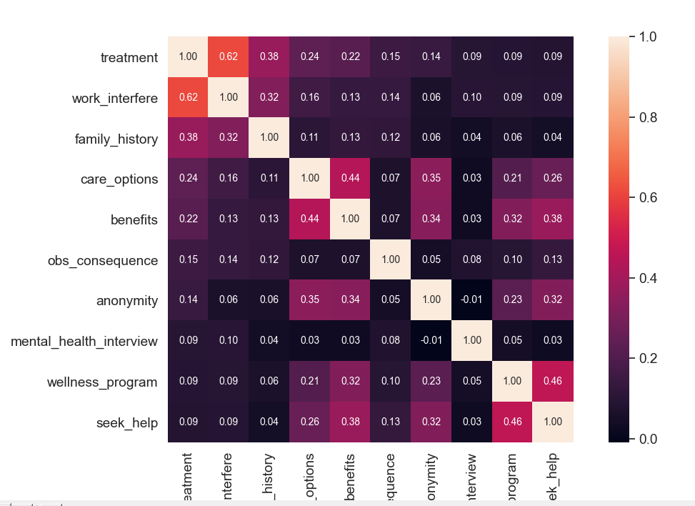
Correlation matrix

Slide 11
Train
3

Slide 12
Training model
SGDClassifier: [0.78498294 0.70307167 0.76450512]
RandomForestClassifier: [0.83959044 0.83276451 0.83959044]
Logistic regression: 0.7777777777777778
SVM Poly: [0.84641638 0.78498294 0.80546075]

Slide 13
Tuning

